Slide 1
Name the Kitchen Tool !

Slide 2
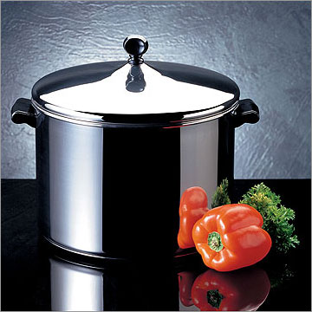
#1 You use this utensil to cook on top of the range. It has 2 short handles.

Slide 3
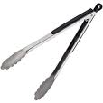
#2 This tool is NOT called a “hot dog Picker-upper”…Although it can be used to pick up a hot dog.

Slide 4
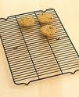
#3 Place Cookies on this wire utensil when they come out of the oven. It lets them Cool.

Slide 5
#4 Use this kitchen tool to get the last bit of cookie dough out of the mixing bowl.

Slide 6
#5 Cook on the stove top in this utensil. It has one handle and low sides.

Slide 7
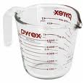
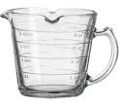
#6 Use this utensil to measure ingredients like milk, water, oil, & syrup

Slide 8
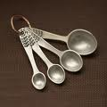
#7 Use this utensil to measure small amounts of liquid or dry ingredients.

Slide 9
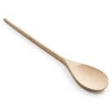
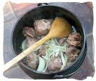
#8 Use this to stir with. Especially good to stir HOT foods with.

Slide 10
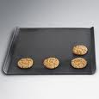
#9 Bake cookies on this kitchen utensil

Slide 11
#10 Use this to flip pancakes or hamburgers. Also use it to remove cookies from a cookie sheet.

Slide 12
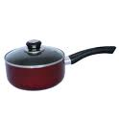
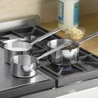
#11 This cookware has ONE handle. Use it on the stove top.

Slide 13
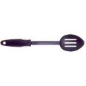
#12 This spoon drains liquids off of food.

Slide 14
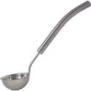
#13 Use this spoon to dip liquid out of a pan---Use it to serve soup.

Slide 15
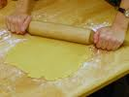
#14 Use this kitchen tool to flatten out pie dough or cookie dough.

Slide 16
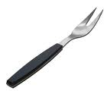
#15 Use this extra large fork to steady meat while you cut it or to lift or turn large pieces of meat.

Slide 17
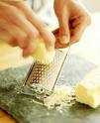
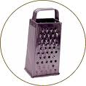
#16 This kitchen tool can be used to shred cheese or vegetables.

Slide 18
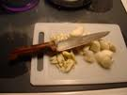
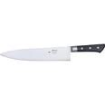
#17 The CURVED blade on this knife makes slicing and dicing safer.

Slide 19
#18 These are NOT regular scissors. They are used to cup-up whole chickens or to mince herbs.

Slide 20
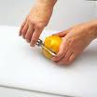
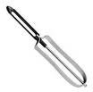
#19 Used to remove the skin from fruits and vegetables.

Slide 21
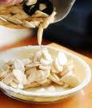
#20 Made of glass or metal, they have slanted sides.

Slide 22
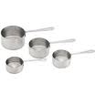
#21 Use these to measure ingredients like flour, sugar, brown sugar, and peanutbutter.

Slide 23
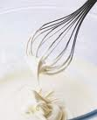
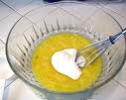
#22 Used to beat or blend ingredients. Especially good for beating eggs.

Slide 24
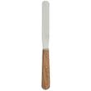
#23 Use this tool to level off ingredients you are measuring.

Slide 25
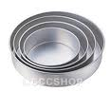
#24 This type of pan comes in many sizes and shapes. Square and Round are the most common shapes.

Slide 26
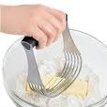
#25 Use this tool to “cut-in” shortening when making pie dough.

Slide 27
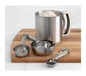
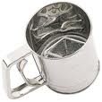
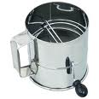
#26 Use this tool to remove lumps from flour or powdered sugar.

Slide 28
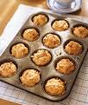
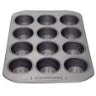
#27 What is the name of this baking pan?

Slide 29
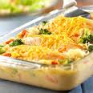
#28 Many shapes Many sizes Some are covered & some are not.

Slide 30
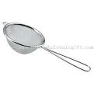
#29 Both are used to drain liquids off foods. Name each one correctly.
#1
#2

Slide 31
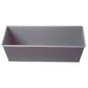
#30 What is this oblong pan called?

Slide 32
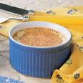
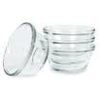
#31 These little dishes have so many uses in the kitchen

Slide 33
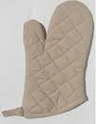
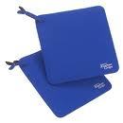
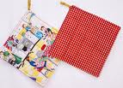
#32 Have these handy when handling HOT cookware.

Slide 34
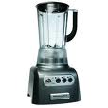
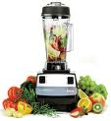
#33 What is the name of this kitchen appliance?

Slide 35
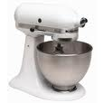
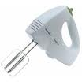
#34 What is this kitchen appliance called?

Slide 36
#35 This protects your counter top when you are chopping up foods.

Slide 37
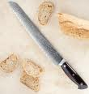
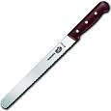
#36 This type of knife has a serrated (sawtooth) edge.

Slide 38
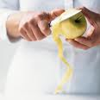
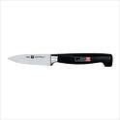
#37 This knife is small and is used to remove skin from fruits & veggies.

