Slide 1
Bell Work
If you were stuck in the woods with only 3 kitchen tools, which ones would you choose and why?

Slide 2
Utensil Mania!

Slide 3
RULES FOR THE GAME:
Send one representative to your kitchen.
Students stand in the center of the kitchen with hands at sides, all drawers and cabinets closed.
Class mates CAN NOT shout directions or answers at the team mate in the kitchen.
The class must be completely silent before a clue is read.
I will read the clue, the first person to hold up the correct utensil gets a point.
Students then put the item away and return to their seats and a new representative reports to the kitchen.

Slide 4
REMINDERS FOR STUDENTS:
Students must wash hands before playing.
Please do not touch the items except by using the handle and don’t rub the item on things or breathe on it excessively. ☺
Put the item back in the correct drawer/cabinet you got it from and make sure that drawer/cabinet remains organized.

Slide 5
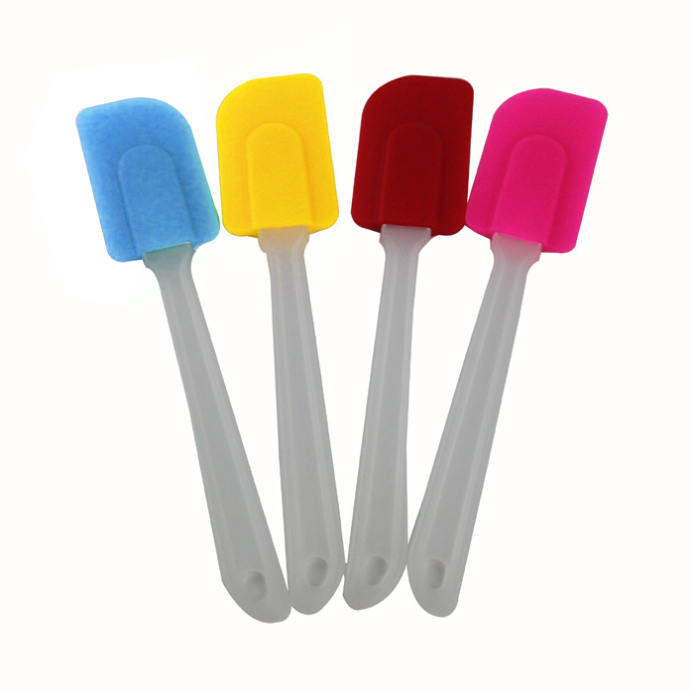
I am used for scraping bowls and saucepans and folding one food into another.
Rubber Scraper

Slide 6
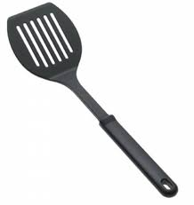
I am used for flipping pancakes and taking cookies off a hot pan. Sponge Bob calls me a spatula, but my actual name is __________.
Turner

Slide 7
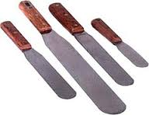
I am long and skinny with a flat edge. I am used for leveling off dry ingredients.
Straight-edge spatula

Slide 8
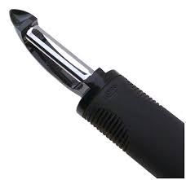
I am used to remove the outer surface of fruits and vegetables.
Peeler

Slide 9
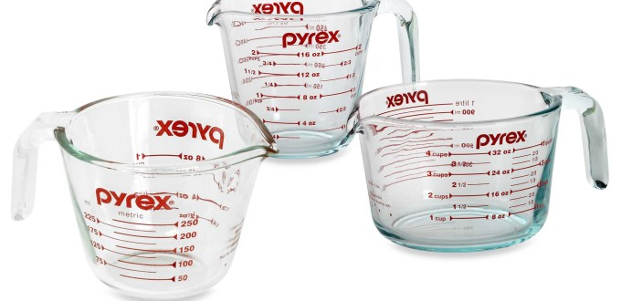
I am made of glass or plastic and am used for measuring ingredients like milk or oil.
Liquid measuring cup

Slide 10
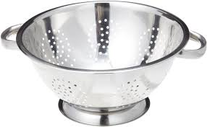
I am used to drain fruits, vegetables, and pasta. I’m commonly referred to as a strainer but my actual name is_______________________.
Colander

Slide 11
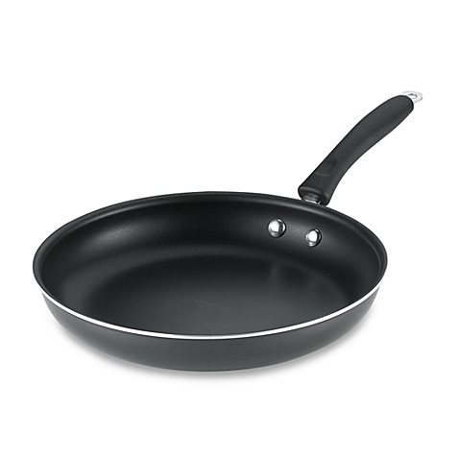
I have one handle and would be used for browning hamburger on the stovetop.
Skillet

Slide 12
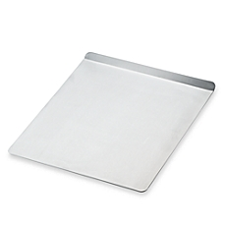
I am a flat sheet of metal used for baking.
Baking Sheet / Cookie Sheet

Slide 13
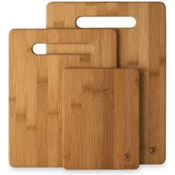
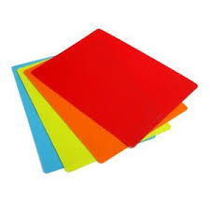
I am used to protect countertops when chopping food.
Cutting Board / Cutting Mat

Slide 14
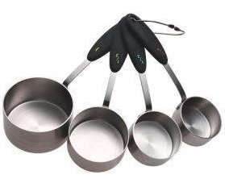
I am made of metal or plastic and am used for measuring ingredients like flour and sugar.
Dry Measuring Cups

Slide 15
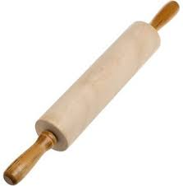
I am used to roll dough or pastry.
Rolling Pin

Slide 16
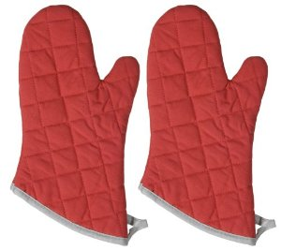
I am used to protect hands from getting burned when taking things out of the oven.
Oven Mitts or Hot Pads

Slide 17
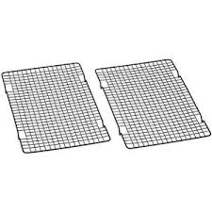
I am used for cooling food items on the counter.
Cooling Rack

Slide 18
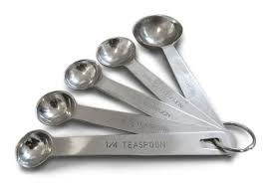
I am used to measure very small amounts of ingredients, less than ¼ cup.
Measuring Spoons

Slide 19
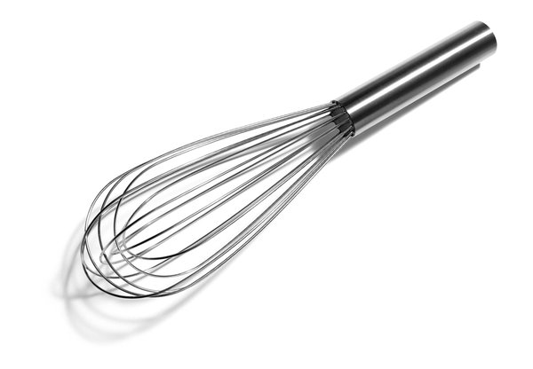
I am used to stir items like eggs…or to whisk items together.
Whisk

Slide 20
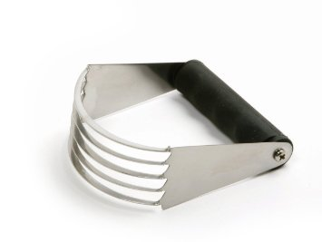
I am several thin, curved pieces of metal attached to a handle and am used for making pie crust and biscuits.
Pastry Blender

Slide 21
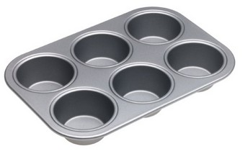
I am on oblong pan with round depressions.
Muffin Tin

